Slide 1
Utility Scale Workshop - Bidding & Optimization
GELI| April 3, 2023

Slide 2
Agenda
Introduction to optimization
Understanding ERCOT
ERCOT optimization approach
Preliminary optimization results
Next steps
Cloud architecture

Slide 3
Introduction to optimization

Slide 4
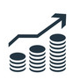
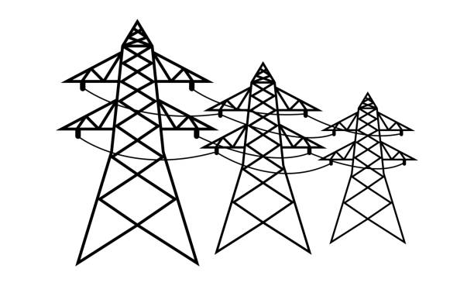





GELI Optimization Platform
Asset Models
Battery Model
Load Control Model
Solar Model
Market Model
Forecasting Models
Optimization Platform
Utility Scale
Machine Learning
Weather Service Integration
Revenue Stack maximization
Renewables and market revenue services
C&I
Resi VPP
Revenue Models
Self-Consumption
DCM/TOU
Demand Response
Wholesale Markets
Spot Market
Ancillary Services
VPP: Virtual power plant
DCM: Demand charge management
TOU: Time-of-use
Notes:
Combination of asset models (battery model, load control model, solar model, etc) and revenue models (DCM, Demand response, Wholesale etc), with associated constraints.
Forecaster- Forecasts load, solar, prices, etc. & Forecasts are updated continually
Optimizer- Schedules profit-maximizing charge and discharge decisions & Updates schedule continually

Slide 5
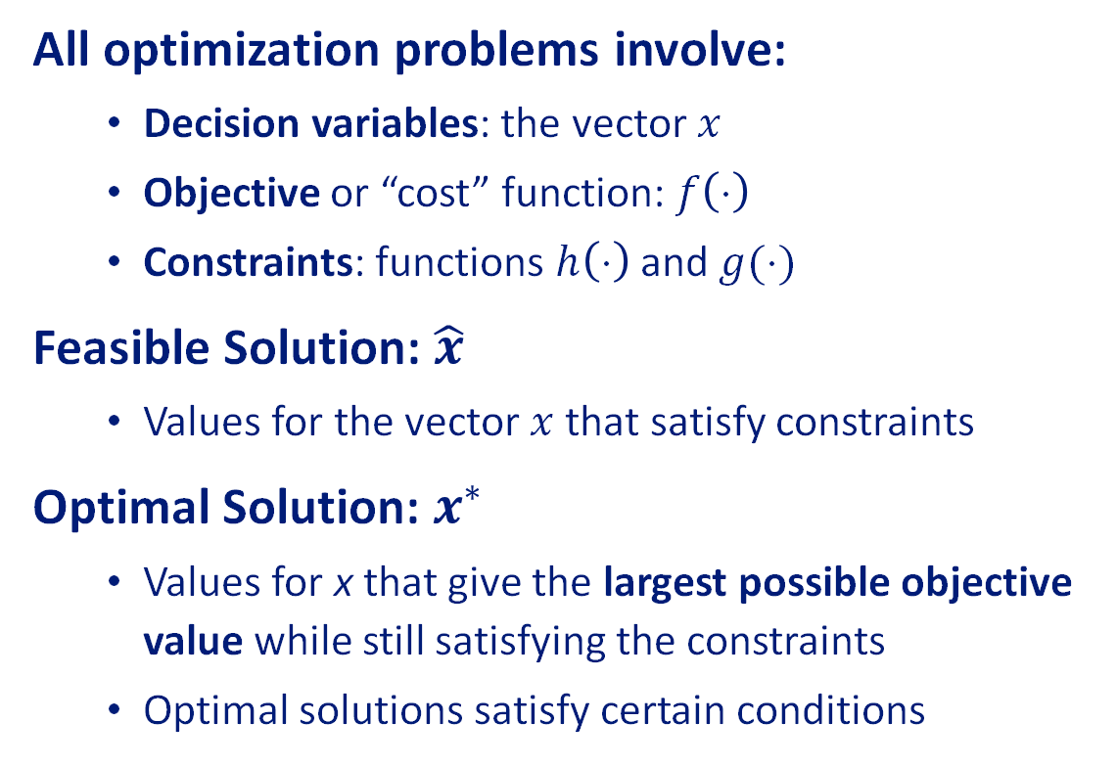
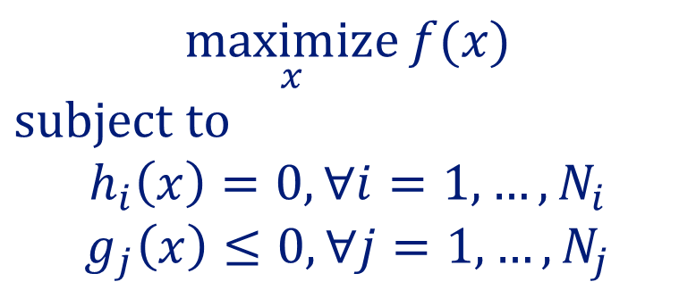
Introduction to Optimization
All optimization problems involve:
Decision variables: the vector $x$
Objective or “cost” function: $f\left(⋅\right)$
Constraints: functions $h\left(⋅\right)$ and $g(⋅)$
Feasible Solution: $\hat{x}$
Values for the vector $x$ that satisfy constraints
Optimal Solution: $x^{∗}$
Values for x that give the largest possible objective value while still satisfying the constraints
Optimal solutions satisfy certain conditions
$$\underset{x}{maximize}{f(x)}$$
$$subject to$$
$$h_{i}\left(x\right)=0, ∀i=1,…, N_{i}$$
$$g_{j}\left(x\right)≤0, ∀j=1, …, N_{j}$$
Notes:
Four minutes
Show what mathematical programming is
What are we trying to achieve: maximization
Subject to constraints and bounds, etc.

Slide 6

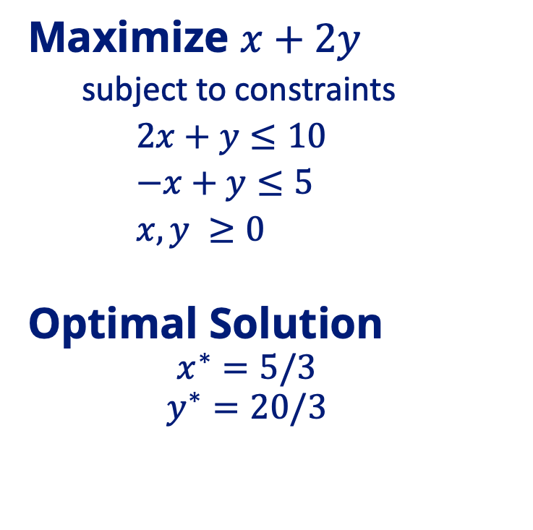
Example Optimization Problem
-x + y ≤ 5
Improving objective
Maximize $x+2y$
subject to constraints
$2x+y≤10$
$−x+y≤5$
$x, y ≥0$
Optimal Solution
$$x^{∗}=5/3$$
$$y^{∗}=20/3$$
Optimal Solution
2x + y ≤ 10
x + 2y
Feasible region
Notes:
Four minutes.
Talk about linear programming and show an example
Add discrete decisions and show how it affects the example
Give a comparison of the example with the size of the ERCOT problem
e.g., it has x times as many variables and y times as many constraints

Slide 7
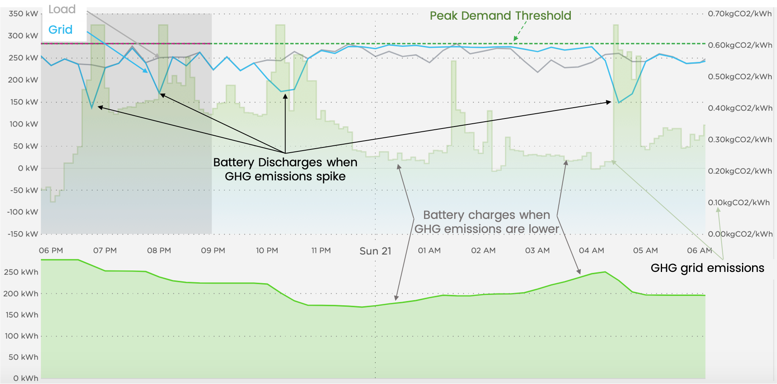
Real World Optimization Application- C&I Example
Demand charge management: keep consumption low
Self-generation Incentive Program (SGIP) greenhouse gas (GHG) reduction: discharge when emissions spike
When GHG intensity spikes, the battery discharges
The battery maintains capacity to attack load peaks
The battery charges while load remains below threshold
Notes:
Four minutes.
Walk through a C&I or residential GELI application
Show the optimization schedule, explain how it makes sense
Emphasize that we are leveraging our existing platform for front-of-meter
This site provides a good example of how GELI co-optimizes two competing economic objectives to maximize overall value to the customer. In this site, GELI is co-optimizing Demand Charge Management with the SGIP GHG reduction. The GHG intensity of the grid is shown in the light shaded green. The current peak demand at the site is shown by the dotted green line labeled “Peak Demand Threshold.” When the carbon intensity of the grid spikes, the battery discharges. However, GELI still aims to maintain battery capacity in order to attack load peaks that may arise. When the carbon intensity of the grid decreases, the battery charges such that the load does not increase above the current peak demand threshold.

Slide 8
Understanding ERCOT

Slide 9
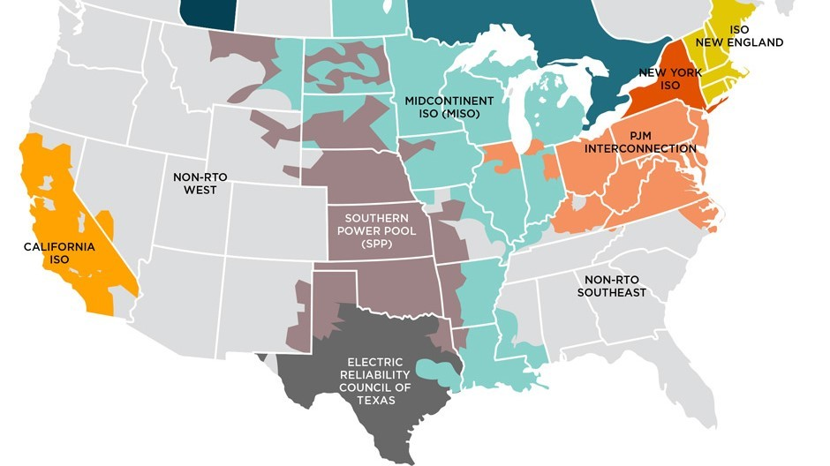
Power market and ERCOT basics
What is a power market?
Power markets can be organized (“ISOs”) or non-organized (gray regions on map)
2 key functions of ISOs - Grid Operator & Exchange
Not all power markets are electrically deregulated³
What is ERCOT?
The Electric Reliability Council of Texas
Quick facts: peak demand 80 GW¹ (90% of TX load), total installed operating capacity 140 GW², 1,800 market participants
Is an energy-only market
Capacity isn’t procured
Supply incentivized purely on market signals
Credit: SustainableFERC
¹On July 20, 2022
²Operational generation capacity, per ERCOT’s CDR report as of November 2022
³See appendix
Notes:
2 functions:
Grid operator - to keep the lights on; balance supply and demand instantly and continuously
Exchange – to buy and sell wholesale electricity
deregulated states use markets to determine which power plants are necessary for electricity generation

Slide 10
Market products in ERCOT
Energy in the Day Ahead Market (“DAM”)
The DAM is a voluntary financial market
Financial purchase & sale of power one day prior to the operating day
Generally, prices premium to RTM but less volatility
Energy in the Real Time Market (“RTM”)
Physical purchase and sale of energy every 5 minutes during the operating day
Generally, lower prices than in DAM but more volatility
Ancillary Services (“AS”) in the DAM
Uncommitted capacity sold by generators and procured by ERCOT
Capacity used as option by ERCOT to request for more or less energy when needed
Results physically binding
3 types of AS:
Regulation (Up & Down) – increase/decrease supply every 4 seconds
Responsive Reserves (“Spin”) – increase remainder online capacity within 10 minutes
Non-spin – increase remainder online/offline capacity within 30 minutes
Notes:
How do you transact in the market?
Energy in the Day Ahead Market (“DAM”)
Voluntary financial market to purchase and sell electricity
Results are financially binding
Mechanism to hedge against price uncertainty in the Real Time
Comprises 95% of all market transactions
Available in all ISOs
Energy in the Real Time Market (“RTM”)
Physically purchase and sell electricity up to every 5 minutes during the entire day
Balancing market to adjust for differences between the day ahead and real-time supply and demand schedules
Available in all ISOs
Ancillary Services (“AS”) in the DAM and RTM
Services sold by generators and procured by the ISO in the DAM to ensure real time grid reliability
Procured AS is charged to loads pro-rata and is paid to generators providing AS
Service types include voltage control, reactive power, frequency control, spinning reserves, and standby power
Available in all ISOs (some ISOs procure AS in both the DAM and RTM)
Capacity (Long-Term)
The North American Electric Reliability Corp (“NERC”) requires electric retailers to ensure they have sufficient generating capacity to meet forecasted load plus a reserve margin
ISOs run auctions for capacity based on projections of electric demand 3 years out
Offers for capacity are “cleared” in order of least cost against the forecasted system demand
Capacity markets are currently only available in PJM, NYISO, MISO, and ISO-NE

Slide 11
ERCOT Target Market Products for FOM Bid Optimization
ERCOT
DA
AS
Responsive Reserves
Contingency Reserves⁸
Regulation
Energy
RegUp¹
RegDn¹
FFR²
UFR³
PFR⁴
RT
Non-Spin⁷
Energy
Generation⁵
Load Resources⁶
Target Market Products
Note: all target AS products are subject to qualification by the participating resource
Accordingly, our target market products are based on the anticipated participation of market products at Cunningham
¹Regulation Up/Down. Full response in 5 seconds. Must sustain for 1 hr.
²Fast Frequency Response. Full response in 15 cycles (15 minutes). Must sustain for 15 minutes.
³Under Frequency Relay. Full response in 30 cycles. Applicable to Non-Controllable Load Resources. Sustained until recalled.
⁴Primary Frequency Response. Full response in 15 to 30 minutes. Must be sustained for 1 hr.
⁵Full response in 10 minutes. Must sustain for 2 hrs.
⁶Full response in 10 minutes. Sustained until recalled.
⁷Full response in 30 minutes. Must sustain for 4 hours.
⁸To be implemented by ERCOT in Q3 2023.
Notes:
Fast Reg – 1 second response
Reg – 5 second response
FFR Spin – 15 minute response
PFR – 15-30 minute response
CRS – 30 minutes response

Slide 12
Capturing ERCOT market rules, subtleties, and evolving market design into model
Market rules:
Market operations timeline
DA and RT market products
Bid and offer validation rules
Market settlements
Subtleties:
Energy Storage Resources (“ESRs”)
Dual-registration - Generator Resource (to discharge) and Controllable Load Resource (to charge)
Bids and offers submission deadline in RTM
SOC management
Evolving market design:
Market offer cap reduction – January 2022
BPM¹ rule change impacting ESRs - December 2022
ERCOT Real Time Co-Optimization (“RTC”) – 2024
ESR single model design – 2024
¹BPM: Business Practice Manual
²SOC: State of Charge
Notes:
Cap reductions – LCAP $2,000, HCAP - $5,000, enforced by PUCT
BPM³ rule change December 2022: An ESR that is carrying Ancillary Service awards must reserve sufficient SOC for the awarded AS⁴ it is carrying in Real Time.
RTC: RTC is the process of dispatching energy and ancillary services interchangeably in the Real-Time Market.
Market rules:
Market operations timeline – DAM and RTM participation deadlines
DA and RT market products – Energy & AS
Bid and offer validation rules – how to create and submit valid bids & offers
Market settlements of DA and RT transactions – how to get paid
Subtleties:
Battery storage resources are known as Energy Storage Resources (“ESRs”) in ERCOT
ESRs must be dually-registered as both a Generator Resource (to discharge) and Controllable Load Resource (to charge)
Bids and offers associated with an ESR may be updated every 5 minutes
QSEs must manage SOC of battery to ensure awards and dispatches are met
Evolving market design:
Market offer cap reductions – January 2022
BPM¹ rule change impacting ESRs - December 2022
ERCOT Real Time Co-Optimization (“RTC”) – 2024
ESR single model design – 2024

Slide 13
Growth in energy generated from wind and solar generation
Since 2012, energy generated from wind and solar resources has increased by over 300%, meanwhile energy generated from coal resources has been cut in half
The increase in this generation is attributable to its decreasing cost of production
As of November 2022, ERCOT had 36 GW (26%) of wind and 14 GW (10%) of solar installed operating capacity
Per ERCOT’s Fuel Mix Report & Lazard’s annual LCOE Report
¹LCOE reflects the average unsubsidized LCOE between the high and low value
²Other means neither of the above technologies
Notes:
The fuel mix of a power market is indicative of market price behavior
Over one-third of ERCOT’s installed capacity is from wind and solar resources, compared to only 13% since just a decade ago
The majority of this was from wind

Slide 14
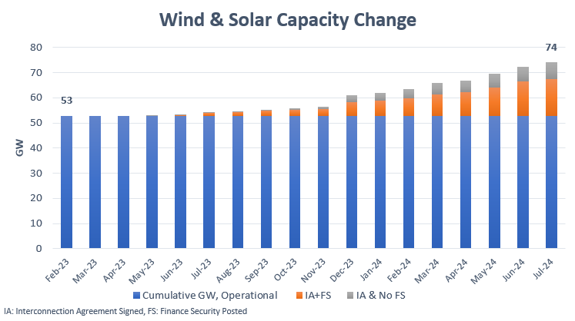
Solar installations on rapid rise
In the next 18 months, total wind and solar installed capacity is expected to increase by 40% to 74 GW
Of the total additions by July 2024, 19 GW is from solar and the remainder is from wind resources
Per ERCOT’s Fuel Change by Type Report
Notes:
Of the 21 GW in additions, less than one-third has no FS yet

Slide 15
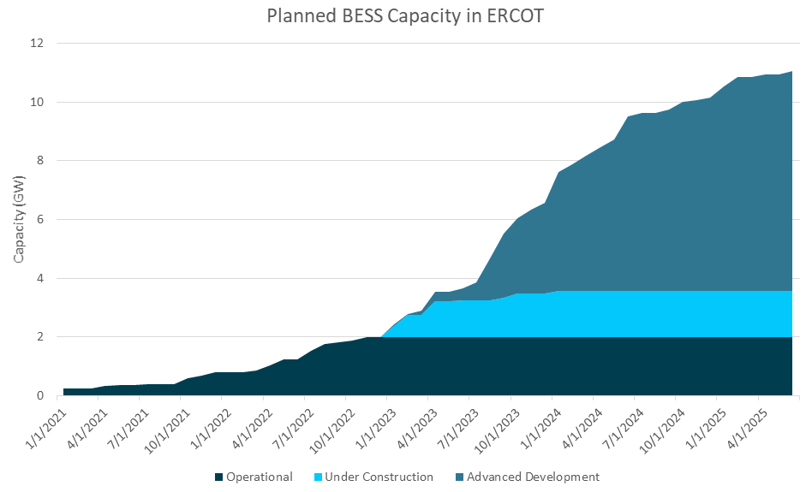
Growth in battery installations complements onset of renewables
Currently, ERCOT has 2 GW of installed utility scale battery capacity, 2nd to CAISO at nearly 5 GW¹
With 1.5 GW of battery under construction² and 7.5 GW in advanced development³, installed battery capacity is expected to reach 11 GW by summer 2025
Credit: BTU Analytics
¹Per S&P Outlook 2022: Solar, battery storage spark CAISO capacity surge
²Under Construction means IA and FS achieved
³Advanced development means either IA or FS achieved

Slide 16
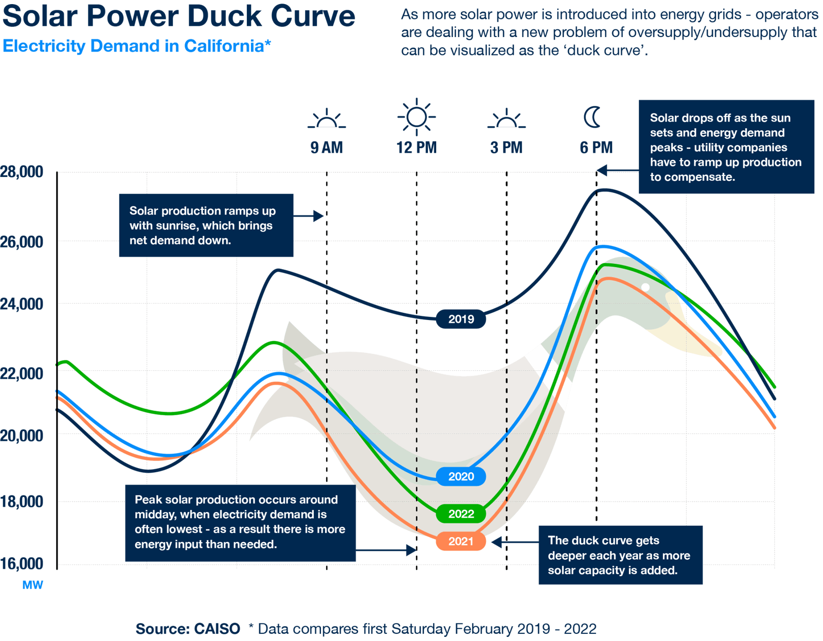
CAISO’s infamous ‘duck curve’ is on the way to ERCOT
A duck curve refers to the effects on the net demand (gross demand minus wind and solar output) pattern observed in CAISO with its increasing penetration of solar and wind output over time
During low load seasons (i.e. spring), the shape in net demand results in a pronounced trough (reduction) in net demand midday when solar output is greatest and demand is often lowest
Before the sun rises and after the sun sets, the net demand will be higher creating sharp ‘peaks’ and higher ramping needs
Demand has a direct 1:1 effect on prices (next slide)
Notes:
A look at the evolution of CAISO battery dynamics may be predictive for ERCOT’s own market.

Slide 17
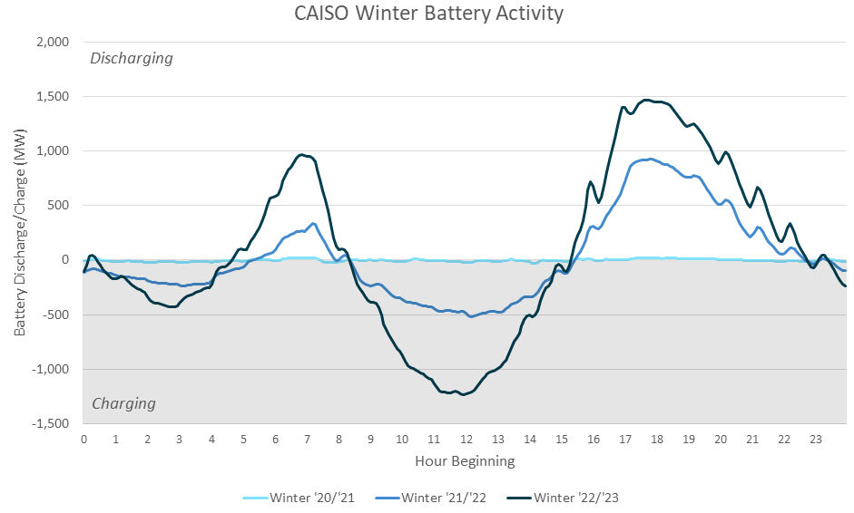
Battery bidding behavior in ERCOT expected to follow suite to CAISO
In the last 2 years, installed BESS capacity in CAISO increased tenfold from 0.5 GW to 5 GW
Per BTU Analytics, CAISO’s rapid buildout of battery coincided with a change in battery bidding behavior
Battery bidding behavior changed from primarily selling regulation services (similar to ERCOT present day) to performing energy arbitrage
Energy arbitrage means charging during the daily minimums in net demand, particularly late at night and during the midday, then discharging during times of peak net load (i.e. evening)
Credit: BTU Analytics
Note: winter defined as November through January. When negative, BESS is charging. Data reported using moving average.
¹ERCOT Battery Dynamics Set to Follow CAISO Trends
Notes:
Battery bidding behavior changed from primarily selling regulation services (similar to ERCOT present day) to performing energy arbitrage when battery operational capacity reached just over 1 GW

Slide 18
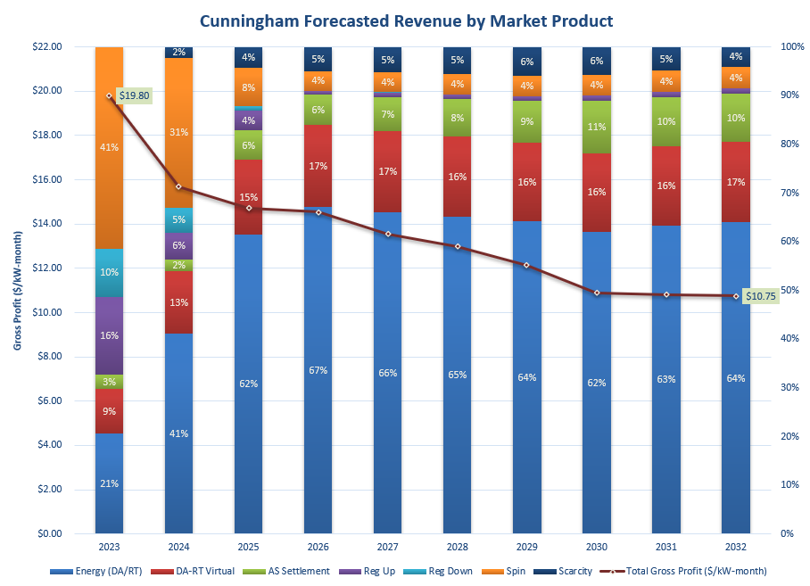
Long term revenue forecast for Cunningham agrees with observed trends
Ascend’s long term revenue model for Cunningham projects the majority of revenue to switch from selling Spin to energy arbitrage starting in 2025
This is due to onset of batteries competing to sell Spin, thus cannibalizing its respective market value
As solar penetration increases, energy arbitrage will become more lucrative given the deeper reduction in net demand midday, thus permitting for peak charging
Per Ascend’s long-term revenue model for Cunningham
Notes:
$45,154,514, 2023
$24,671,057, 2032
ERCOT has traditionally had the highest prices for Spin due to high wind penetration causing for large ramp needs

Slide 19
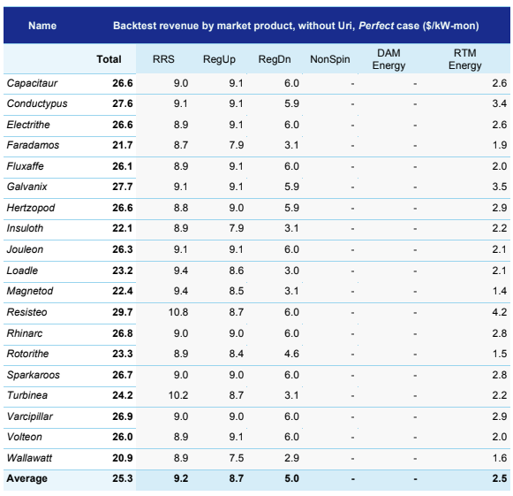
How much profit could batteries make in ERCOT with perfect foresight?
Based on a study¹, the table on the left shows gross profit batteries in ERCOT would have made in 2021 (excluding the period⁴ of Winter Storm Uri) using perfect foresight of market prices
Key takeaways:
With perfect foresight^{2,3}, batteries could have earned an annual avg. gross profit of $25/kW-month
RRS and RegUp contributed the greatest to total gross profit
RTM Energy⁵ revenue is from RTM energy arbitrage – “energy operations will grow in importance as ancillary service markets saturate” (per Gridmatic)
¹This study was performed by Gridmatic and validated by DNV
²Due to market rules limits storage participation in non-spin, it was not considered as part of this study
³In order to present a conservative uplift case, DAM Energy participation (DART arbitrage considered Gridmatic’s core trading business) was also not considered in this study
⁴2/12/2021-2/22/2021
⁵RTM energy revenue was calculated using 15-min actual generation, consumption and Settlement Point Prices from Disclosure Reports
Credit: DNV
Notes:
Gridmatic is an AI-enabled power marketer founded in 2017 with the objective of applying machine-learning algorithms to the problem of forecasting energy supply, demand, and pricing in wholesale energy markets.
Battery sizes:
Size: 2 MW – 100 MW / 1 to 4.2 MWh
Cycling limit: 365 per year
Gross profit has a lower bound of $20 to high of $30

Slide 20
ERCOT optimization approach

Slide 21
Optimization Model Summary
The work completed so far is a foundational starting point.
We optimize combined energy arbitrage within DA and RT energy markets.
We simultaneously optimize combined ancillary service power allocations.
We act as a price-taker: we bid at the market cap and offer at the floor.
We commit to pending and awarded trades in all markets and services.
We ensure operational feasibility by physically modeling the battery.

Slide 22
Optimization Model Variables
Physical discharge power (generation)
Physical charge power (load)
Stored energy (“state of charge”)
Day ahead energy purchases/sales
Real-time energy purchases/sales
Regulation-up/-down gen/load sales
Responsive reserve gen/load sales
Notes:
Four minutes.

Slide 23
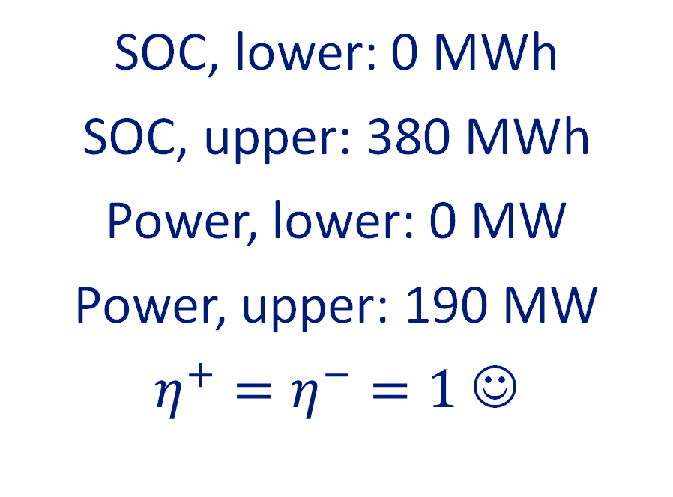
Parameters: Physical Limits
State of charge lower, upper limits
Generation lower, upper limits
Load lower, upper limits
Charge, discharge efficiencies
Cunningham
SOC, lower: 0 MWh
SOC, upper: 380 MWh
Power, lower: 0 MW
Power, upper: 190 MW
$η^{+}=η^{−}=1$ ☺
Notes:
Four minutes.

Slide 24
Parameters: Markets and AS Utilization
Energy and ancillary service prices
Ancillary service dispatch levels
Expected gen. ancillary service use
Expected load ancillary service use
All quantities must be forecasted!
We assume perfect foresight hereafter
Notes:
Four minutes.

Slide 25
Parameters: User-defined Limits
Proportional discharge limits
Proportional charge limits
Allows the user to bias power allocations toward one market/service or another
In the absence of probabilistic price forecasts, enables heuristic alternatives
Notes:
Four minutes.

Slide 26

Optimization Objective
$$maximize \sum_{t∈𝒯}{\begin{aligned}Δt\left(\begin{aligned}π_{t}^{DA}\left[P_{t}^{DA+}−P_{t}^{DA−}\right] \\ +π_{t}^{RT}\left[P_{t}^{RT+}−P_{t}^{RT−}\right]\end{aligned}\right) \\ + Δt\left(\begin{aligned}π_{t}^{R↑}\left[ΔP_{t}^{R↑+}+ΔP_{t}^{R↑−}\right] \\ +π_{t}^{R↓}\left[ΔP_{t}^{R↓+}+ΔP_{t}^{R↓−}\right] \\ +π_{t}^{RRS}\left[ΔP_{t}^{RRS+}+ΔP_{t}^{RRS−}\right]\end{aligned}\right) \\ + Δt\left(\begin{aligned}π_{t}^{RT}β_{t}^{R↑+}ΔP_{t}^{R↑+} \\ +{π_{t}^{RT}β}_{t}^{R↑+}ΔP_{t}^{R↑+} \\ −{π_{t}^{RT}β}_{t}^{R↓+}ΔP_{t}^{R↓+} \\ −{π_{t}^{RT}β}_{t}^{R↓+}ΔP_{t}^{R↓+} \\ +{π_{t}^{RT}β}_{t}^{RRS+}ΔP_{t}^{RRS+} \\ +{π_{t}^{RT}β}_{t}^{RRS−}ΔP_{t}^{RRS−}\end{aligned}\right) \\ − Δtπ^{h}P_{t}^{+}\end{aligned}}$$
Energy arbitrage
Ancillary services
Ancillary service energy true-up
Throughput (cycling) penalty
Notes:
Five minutes.

Slide 27
Optimization Constraints
Energy, charging power, and discharging power bounds
Charging and discharging complementarity
Energy market and ancillary service award limits
Ancillary service headroom limits, based on energy market commitments
Temporal modeling of the battery’s state of charge
Partitioning of physical and market power quantities
User-defined energy market and ancillary service power limits
Notes:
Five minutes.

Slide 28
Preliminary optimization results

Slide 29
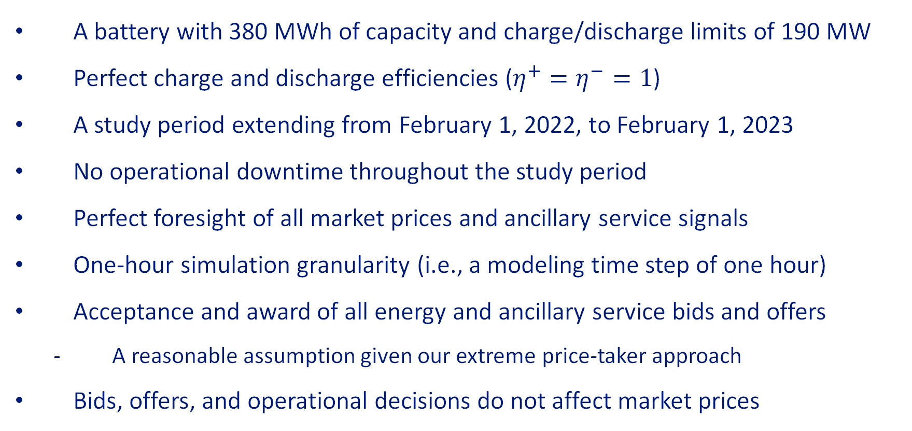
Perfect Foresight Assumptions
A battery with 380 MWh of capacity and charge/discharge limits of 190 MW
Perfect charge and discharge efficiencies ($η^{+}=η^{−}=1$)
A study period extending from February 1, 2022, to February 1, 2023
No operational downtime throughout the study period
Perfect foresight of all market prices and ancillary service signals
One-hour simulation granularity (i.e., a modeling time step of one hour)
Acceptance and award of all energy and ancillary service bids and offers
A reasonable assumption given our extreme price-taker approach
Bids, offers, and operational decisions do not affect market prices
Notes:
Five minutes.

Slide 30
Perfect Foresight Results
Nearly 1,000 charge/discharge cycles
Note the plot of prices is logarithmic
Around $57MM in yearly profit*
Large revenue spikes during price peaks
*These are preliminary theoretical maxima, not attainable for projects
Notes:
Four minutes.
In big, bold letters: this is a best-case scenario. We do not anticipate these profits to be realized in practice. Consider these results as upper bounds on profit.
Show the base perfect foresight simulation (no limit on cycles) and discuss the behavior. Point out how ancillary services are coordinated with respect to price and utilization to take advantage of layering charging and discharging behavior with real-time prices.

Slide 31
Perfect Foresight Results: Zoom-in
Notes:
Four minutes.
In big, bold letters: this is a best-case scenario. We do not anticipate these profits to be realized in practice. Consider these results as upper bounds on profit.
Show the base perfect foresight simulation (no limit on cycles) and discuss the behavior. Point out how ancillary services are coordinated with respect to price and utilization to take advantage of layering charging and discharging behavior with real-time prices.

Slide 32
Perfect Foresight Profit: $57.54MM ($25.23/kW-month)*
*These are preliminary theoretical maxima, not attainable for projects
Notes:
Four minutes.
In big, bold letters: this is a best-case scenario. We do not anticipate these profits to be realized in practice. Consider these results as upper bounds on profit.
Show the base perfect foresight simulation (no limit on cycles) and discuss the behavior. Point out how ancillary services are coordinated with respect to price and utilization to take advantage of layering charging and discharging behavior with real-time prices.

Slide 33
Effect of Cycling Limits on Profit*
93% of max profit using 365 cycles
As cycle limit increases, profit increases
365 cycles
*These are preliminary theoretical maxima, not attainable for projects
Notes:
Three minutes.
Show the effects of varying hurdle price on (1) the number of cycles discharged over the study period and (2) the profit achieved over the year.

Slide 34
Configurable Participation Revenue (No Throughput Cost)*
*These are preliminary theoretical maxima, not attainable for projects
Notes:
Four minutes.
Show the effect of changing market allocations, e.g., (1) turn off day-ahead energy participation, (2) turn off all ancillary service participation, (3) only do real-time and responsive reserve, (4) only do 10% day-ahead energy and rest real-time. Show pie charts of cost/revenue and total profit for each scenario.

Slide 35
Worst-case Ancillary Service Limits ($50/MWh Throughput)
Revenue Sources by Market Participation
Throughput cost
$0/MWh
Revenue Sources by Market Participation
Throughput cost
$50/MWh
*These are preliminary theoretical maxima, not attainable for projects
Notes:
Three minutes.
Show how we deal with worst-case ancillary service signals and how they impact the expected profit and ancillary service offers. Suggest how we might improve this in the future.

Slide 36
Summary of Initial Results*
Scenario | Throughput Cost | Profit | Cycles
Best Case No Cycling Limits | $0/MWh | $57.54MM, $25.23/kW-month | 980.0
Base Case 365 Max Cycles | $50/MWh | $53.69MM, $23.54/kW-month | 364.3
Worst-Case AS Utilization (Gen.) | $50/MWh | $31.49MM, $13.81/kW-month | 334.0
*These are preliminary theoretical maxima, not attainable for projects
Notes:
Break-even: $12-$14/kW-month pays back close to 8% IRR on Cunningham

Slide 37
Next steps

Slide 38
Next Steps for Optimization
Incorporation of forecast prices and AS utilization in simulation control loop
Crucial for understanding model performance in a realistic context
Five-minute real-time energy bidding (instead of one hour)
Hyperparameter tuning for market allocations (heuristic strategy)
Modeling recourse for ancillary services under worst-case assumptions
The current worst-case modeling approach is overly conservative
Stochastic optimization using probabilistic price and utilization forecast
This will enable the creation of more complex bid/offer curves
Notes:
Three minutes.

Slide 39
Productization road map
Benchmarking Part 1
Report benchmarking results periodically
Fine tune model to continue to produce maximum achievable profit
Optimization
Price-sensitive bids & offers
User-defined trading strategy
Benchmarking Part 2
5-minute bids & offers
Report benchmarking results using 5-minute and price-sensitive bids & offers
Fine tune model to continue to produce maximum achievable profit
Bid Submission Data Flow
Modify micro service to ingest Geli bids and submit to ERCOT
Create additional infrastructure for FOM bidding architecture
Forecasting
AS price forecasts
AS utilization forecasts
Probabilistic and deterministic price forecasts for all products

Slide 40
Productization - simulation and benchmarking
Objective:
Generate the financial results of the optimal schedule using Geli bids
Compare financial results of Geli- vs. Ascend-generated bids
Simulation assumptions:
DAM schedules and RTM schedules are forced using price-taker strategy (via extreme price bidding)
DAM awards for energy are carried through into the RTM
AS utilization⁴ applied to determine expected SOC during operating hour
Actual HSL² (Availability) reflected during simulation horizon
Scenarios:
Ascend optimization – actual results with bidding performed by Ascend
Geli optimization – using Geli bids and price forecasts³
Benchmark period: May¹ through October 2023
Goals:
Achieve maximum gross profit
Identify drivers of revenue to create bidding strategy
Improve bidding & optimization performance
Validate feasibility of optimization results
¹Subject to COD for Cunningham
²HSL- High Sustained Limit
³Using both vendor and Geli price forecasts
⁴Forecast AS utilization currently in development, assumption for benchmarking TBD
Notes:
AS assumption options: worst-case, historical, or constant

Slide 41
Productization - benchmarking process
Phase | Description | Price Forecast Used | Simulation Horizon Start Date¹ | Simulation Horizon End Date¹ | Benchmark Run Date¹
1 | Soft simulation feature testing using raw vendor price forecast | Vendor | April 3, 2023 | April 14, 2023 | April 19, 2023
2 | First benchmark, using raw vendor price forecast | Vendor | May 1, 2023² | May 31, 2023 | June 2, 2023
3 | True benchmark, using Geli price forecast | Vendor + Geli Price Corrections | May 1, 2023² | May 31, 2023 | June 9, 2023
4 | Ongoing monthly benchmarking | Vendor + Geli Price Corrections | May 1, 2023² | October 31, 2023 | Recurring monthly (1st week of following month)
¹All dates are tentative and subject to change based on software development
²Subject to Cunningham COD
Notes:
Define ‘worst-case

Slide 42
Productization - establishing a baseline bid strategy
A sensible baseline bid strategy:
Should permit for risk adjustment (i.e. cycling limits, % of HSL allocated to Energy/AS)
Must generate maximum achievable profit
Must be practical - abides by battery’s physical parameters as well market rules
Existing strategy considerations:
Sell Regulation Down at Charge node – offsets cost of charging in the RTM
Enforce ‘hurdle cost’ penalty – establishes an opportunity cost to discharge
Sell AS at both charge and discharge node simultaneously – adds to revenue value stack
Leverage historical AS utilization on sales of AS at charge node
Future strategy considerations:
Leverage 5-minute bid & offer submissions
Leverage forecasted AS utilization – to manage SOC¹ in the RTM
Maximize revenue from DA-RT spread
Identify seasonal trends in optimal allocation of capacity between DA and RT – for custom bid solutions for customer
Leverage switching AS obligation between charge and discharge nodes – for RTM operation flexibility
¹State of Charge

Slide 43
Thank you

Slide 44
Citations
https://insight.factset.com/ercot-battery-dynamics-set-to-follow-caiso-trends
https://insight.factset.com/battery-buildout-in-ercot-to-deliver-a-shock
https://www.spglobal.com/marketintelligence/en/news-insights/research/hourly-profiles-drive-divergent-green-prospects-in-ercot-caiso
https://btuanalytics.com/power-and-renewables/batteries-take-charge-in-caiso/
https://www.energy.ca.gov/media/3757
https://www.energy-storage.news/battery-storage-can-help-solve-texas-super-duck-challenge-of-integrating-renewable-energy/

Slide 45
Appendix

Slide 46
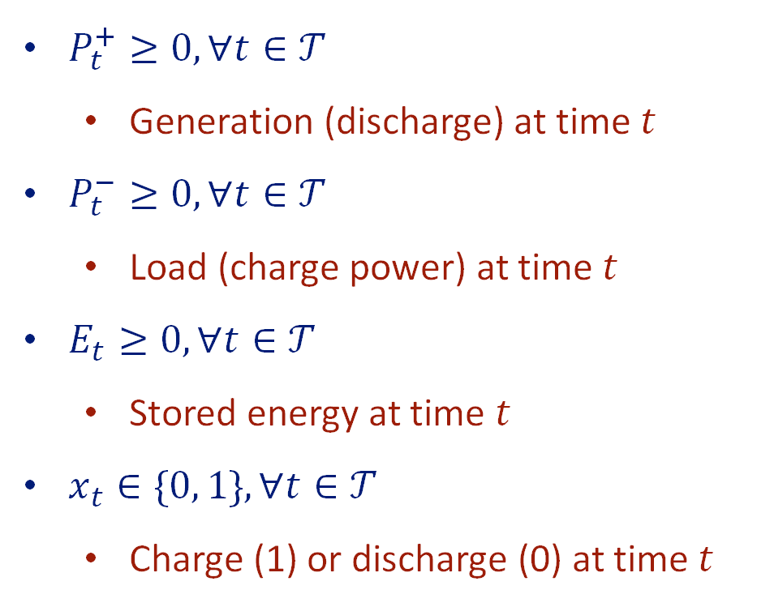
Variables: Battery Physics
$P_{t}^{+}≥0, ∀t∈𝒯$
Generation (discharge) at time $t$
$P_{t}^{−}≥0, ∀t∈𝒯$
Load (charge power) at time $t$
$E_{t}≥0, ∀t∈𝒯$
Stored energy at time $t$
$x_{t}∈\{0, 1\}, ∀t∈𝒯$
Charge (1) or discharge (0) at time $t$
Notes:
Four minutes.

Slide 47
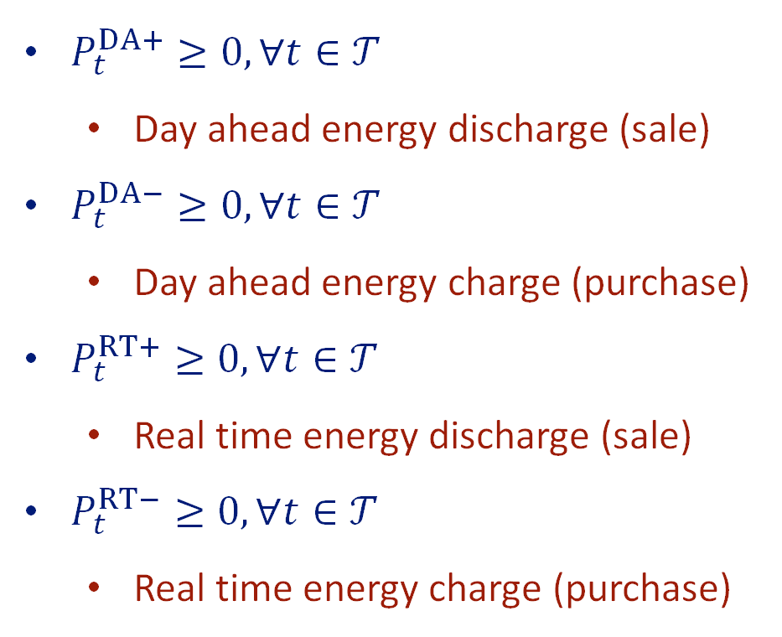
Variables: Energy Markets
$P_{t}^{DA+}≥0, ∀t∈𝒯$
Day ahead energy discharge (sale)
$P_{t}^{DA−}≥0, ∀t∈𝒯$
Day ahead energy charge (purchase)
$P_{t}^{RT+}≥0, ∀t∈𝒯$
Real time energy discharge (sale)
$P_{t}^{RT−}≥0, ∀t∈𝒯$
Real time energy charge (purchase)
Notes:
Four minutes.

Slide 48
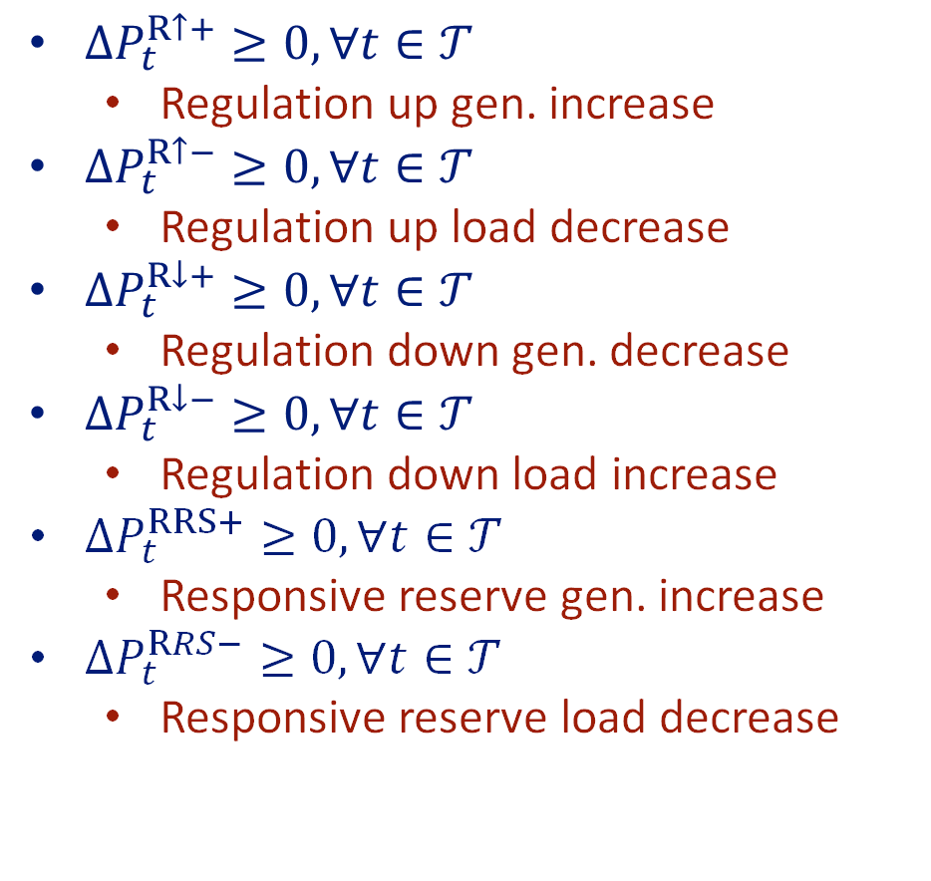
Variables: Ancillary Services
${ΔP}_{t}^{R↑+}≥0, ∀t∈𝒯$
Regulation up gen. increase
${ΔP}_{t}^{R↑−}≥0, ∀t∈𝒯$
Regulation up load decrease
${ΔP}_{t}^{R↓+}≥0, ∀t∈𝒯$
Regulation down gen. decrease
${ΔP}_{t}^{R↓−}≥0, ∀t∈𝒯$
Regulation down load increase
${ΔP}_{t}^{RRS+}≥0, ∀t∈𝒯$
Responsive reserve gen. increase
${ΔP}_{t}^{RRS−}≥0, ∀t∈𝒯$
Responsive reserve load decrease
Notes:
Four minutes.

Slide 49

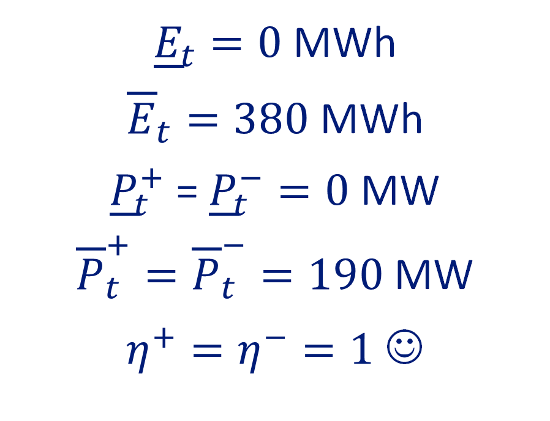
Parameters: Physical Limits
${\underline{E}}_{t}, {\overline{E}}_{t}≥0, ∀t∈𝒯$
State of charge lower, upper bounds
${\underline{P}}_{t}^{+}, {\overline{P}}_{t}^{+}≥0, ∀t∈𝒯$
Generation lower, upper bounds
${\underline{P}}_{t}^{−}, {\overline{P}}_{t}^{−}≥0, ∀t∈𝒯$
Load lower, upper bounds
$η^{−}, η^{+}∈(0, 1]$
Charge, discharge efficiencies
Cunningham
${\underline{E}}_{t}=0$ MWh
${\overline{E}}_{t}=380$ MWh
${\underline{P}}_{t}^{+}$ = ${\underline{P}}_{t}^{−}=0$ MW
${\overline{P}}_{t}^{+}={\overline{P}}_{t}^{−}=190$ MW
$η^{+}=η^{−}=1$ ☺
Notes:
Four minutes.

Slide 50
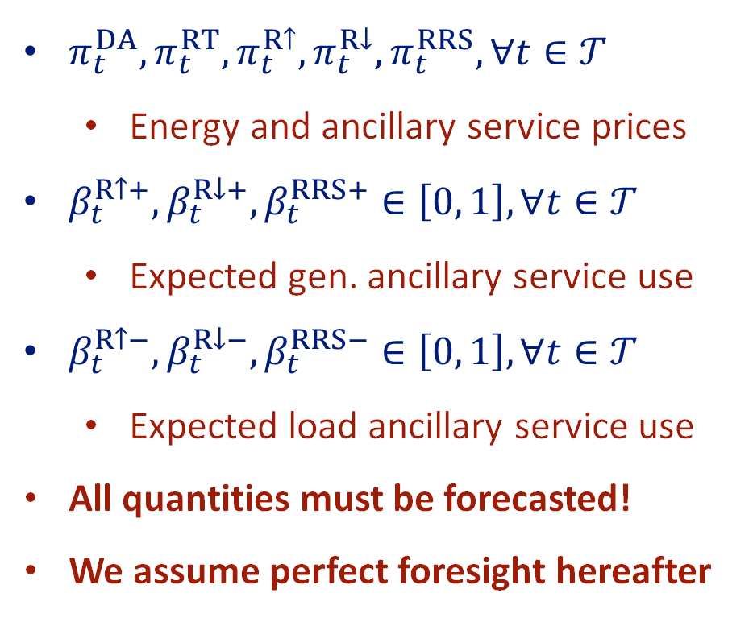
Parameters: Markets and Utilization
$π_{t}^{DA},π_{t}^{RT},π_{t}^{R↑},π_{t}^{R↓},π_{t}^{RRS}, ∀t∈𝒯$
Energy and ancillary service prices
$β_{t}^{R↑+},β_{t}^{R↓+},β_{t}^{RRS+}∈\left[0, 1\right], ∀t∈𝒯$
Expected gen. ancillary service use
$β_{t}^{R↑−},β_{t}^{R↓−},β_{t}^{RRS−}∈\left[0, 1\right], ∀t∈𝒯$
Expected load ancillary service use
All quantities must be forecasted!
We assume perfect foresight hereafter
Notes:
Four minutes.

Slide 51
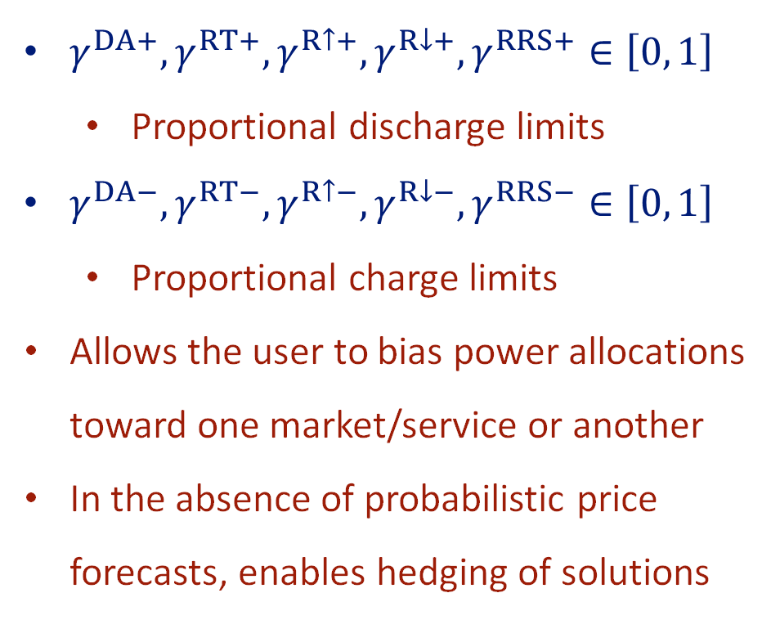
Parameters: User-defined Limits
$γ^{DA+}, γ^{RT+}, γ^{R↑+}, γ^{R↓+}, γ^{RRS+}∈\left[0, 1\right]$
Proportional discharge limits
$γ^{DA−}, γ^{RT−}, γ^{R↑−}, γ^{R↓−}, γ^{RRS−}∈\left[0, 1\right]$
Proportional charge limits
Allows the user to bias power allocations toward one market/service or another
In the absence of probabilistic price forecasts, enables hedging of solutions
Notes:
Four minutes.

Slide 52
Optimization Objective
$$maximize \sum_{t∈𝒯}{\begin{aligned}Δt\left(\begin{aligned}π_{t}^{DA}\left[P_{t}^{DA+}−P_{t}^{DA−}\right] \\ +π_{t}^{RT}\left[P_{t}^{RT+}−P_{t}^{RT−}\right]\end{aligned}\right) \\ + Δt\left(\begin{aligned}π_{t}^{R↑}\left[ΔP_{t}^{R↑+}+ΔP_{t}^{R↑−}\right] \\ +π_{t}^{R↓}\left[ΔP_{t}^{R↓+}+ΔP_{t}^{R↓−}\right] \\ +π_{t}^{RRS}\left[ΔP_{t}^{RRS+}+ΔP_{t}^{RRS−}\right]\end{aligned}\right) \\ + Δt\left(\begin{aligned}π_{t}^{RT}β_{t}^{R↑+}ΔP_{t}^{R↑+} \\ +{π_{t}^{RT}β}_{t}^{R↑+}ΔP_{t}^{R↑+} \\ −{π_{t}^{RT}β}_{t}^{R↓+}ΔP_{t}^{R↓+} \\ −{π_{t}^{RT}β}_{t}^{R↓+}ΔP_{t}^{R↓+} \\ +{π_{t}^{RT}β}_{t}^{RRS+}ΔP_{t}^{RRS+} \\ +{π_{t}^{RT}β}_{t}^{RRS−}ΔP_{t}^{RRS−}\end{aligned}\right) \\ − Δtπ^{h}P_{t}^{+}\end{aligned}}$$
Energy arbitrage
Ancillary services
Ancillary service energy true-up
Discharge hurdle
Notes:
Five minutes.

Slide 53
Optimization Constraints
Energy, charging power, and discharging power bounds
Charging and discharging complementarity
Energy market and ancillary service award limits
Ancillary service headroom limits, based on energy market commitments
Temporal modeling of the battery’s state of charge
Partitioning of physical and market power quantities
User-defined energy market and ancillary service power limits
Notes:
Five minutes.

Slide 54
Effect of Throughput Cost on Cycling
365 cycles
*These are preliminary theoretical maxima, not attainable for projects
Notes:
Three minutes.
Show the effects of varying hurdle price on (1) the number of cycles discharged over the study period and (2) the profit achieved over the year.

Slide 55
Ten-year Revenue Forecast (Day-ahead Energy Only)
Effect of Hurdle Price on Cycling
365 cycles
Notes:
Three minutes.
Show the effects of varying hurdle price on (1) the number of cycles discharged over the study period and (2) the profit achieved over the year.

Slide 56
Ten-year Revenue Forecast (Day-ahead Energy Only)
Effect of Cycling Limits on Profit
Notes:
Three minutes.
Show the effects of varying hurdle price on (1) the number of cycles discharged over the study period and (2) the profit achieved over the year.

Slide 57
Configurable Participation (0 USD/MWh Throughput Cost)*
Throughput cost
$0/MWh
Throughput cost
$0/MWh
Throughput cost
$0/MWh
Throughput cost
$0/MWh
*These are preliminary theoretical maxima, not attainable for projects
Notes:
Four minutes.
Show the effect of changing market allocations, e.g., (1) turn off day-ahead energy participation, (2) turn off all ancillary service participation, (3) only do real-time and responsive reserve, (4) only do 10% day-ahead energy and rest real-time. Show pie charts of cost/revenue and total profit for each scenario.

Slide 58
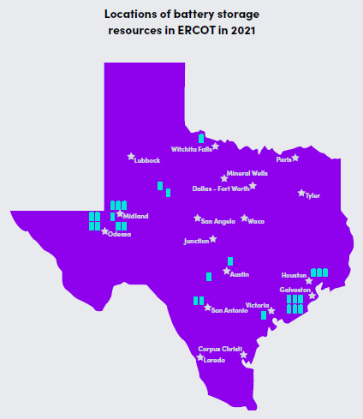
Gridmatic Study – Perfect Foresight Assumptions
Projects studied: 19 commercial batteries
Size: 2 MW – 100 MW / 1 to 4.2 MWh
Study period: 1/1/2021 to 12/31/2021
Perfect foresight: means the maximum revenue that can be achieved in a backcast simulation, assuming perfect foresight of market prices and ancillary service deployments
Assumptions:
All projects had COD prior to 9/30/2021
Cycling limit: 365/year
Regulation deployment: means energy to DAM award ratio, based on actual 4-second interval AGC data from ERCOT
Perfect Scheduler:
Is a relaxation of that upper bound such that it shows reasonably achievable results
No free reign with respect to cycling
Notes:
Gridmatic is an AI-enabled power marketer founded in 2017 with the objective of applying machine-learning algorithms to the problem of forecasting energy supply, demand, and pricing in wholesale energy markets.
Gross profit has a lower bound of $20 to high of $30

Slide 59
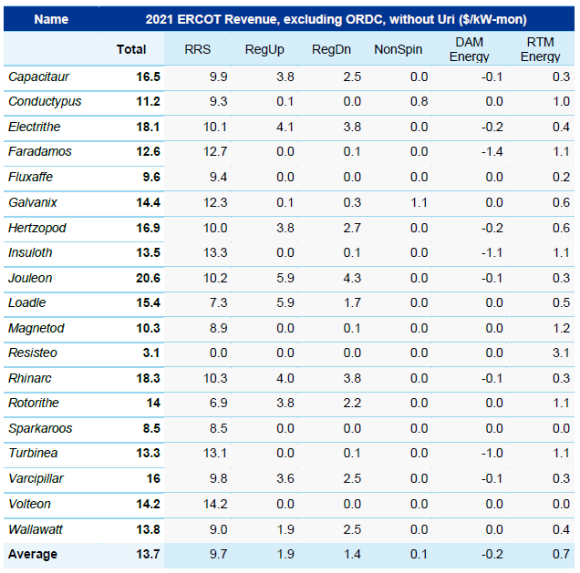
How much actual profit did batteries make in ERCOT?
Based on a study¹, the table on the left shows actual² gross profit select batteries made in ERCOT in 2021
Key takeaways:
Excluding the period of Winter Storm Uri, batteries earned an annual avg. gross profit of $14/kW-month
Inclusive of Uri, batteries earned an annual avg. of $233/kW-month
AS was the dominant source of revenue (96%) for commercial storage projects in ERCOT
Earning revenue is peaky – the top 10% of revenue days accounted for 27-54% of the entire annual revenue
¹This study was performed by Gridmatic and validated by DNV
²Using 60-Day DAM Disclosure Reports
Credit: DNV
Notes:
Gridmatic is an AI-enabled power marketer founded in 2017 with the objective of applying machine-learning algorithms to the problem of forecasting energy supply, demand, and pricing in wholesale energy markets.
Gross profit has a lower bound of $20 to high of $30

Slide 60
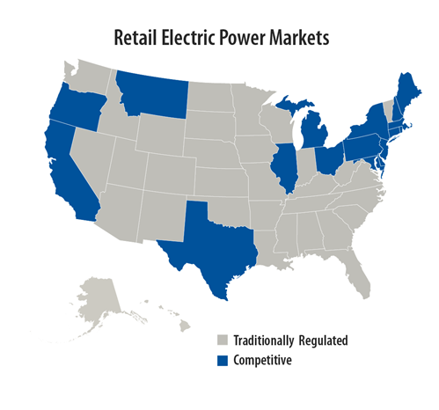
Where are deregulated electric markets in North America?
Participation in electric deregulation is voluntary
Today, there are 19 states that are electrically deregulated
In deregulated states, homes and businesses can “shop around” and select their Retail Energy Provider (“REP”) of choice; this is known as “Retail Choice”
REPs compete for customers and procure their customers’ power needs from wholesale power markets, or via Power Purchase Agreements (“PPAs”) with IPPs
Investor-owned utilities make up the bulk of electric utility providers within traditionally regulated power markets
Others include public power and co-ops
In traditionally regulated markets, electric utilities may supply power from their own fleet, from PPAs, or via bilateral power trades with other neighboring utilities
Credit: EPA
Notes:
In both the regulated and unregulated markets, the state public utility commission still regulates the rates the utility company changes to customers
Regulated electricity markets dominate most of the Southeast, Northwest and much of the West (excluding California)
Vertically integrated utilities – generally investor-owned utilities; serve over 70% of the electric customers in the U.S.
In traditionally regulated electric markets, rates are regulated by the PUC
Rates recover operating and investment costs, including earing a “fair” rate of return on those investments; known as revenue requirements

